Slide 1
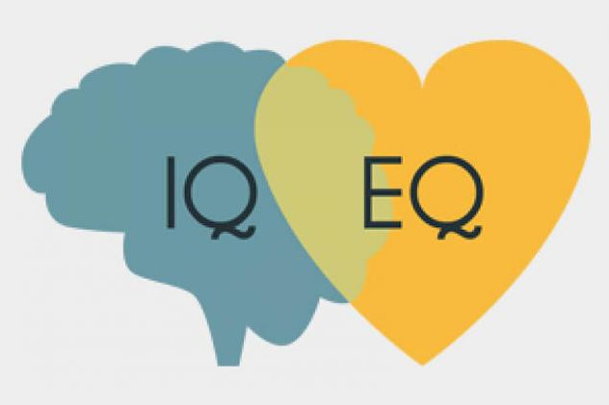
Emotional Intelligence
Bhagya Hapuarachchi
National Institute of Business Management

Slide 2
Aims for Today’s Session
To understand the concepts of emotion and emotional intelligence
To discuss how emotional intelligence can help improve communication

Slide 3
Content
Emotions
What is EI?
Models of EI
4 Domains of EI
Organisational EI

Slide 4
Emotions are contagious.

Slide 5
Emotions
Emotions/Feelings can be used to motivate, plan, and achieve certain aspects in life.
When an individual is capable of regulating his/her emotions well, it is beneficial in managing relationships with others.

Slide 6
Emotions Cont.
A tradition which was popular in the Western world was that emotions are disruptive.
Pubililius Syrus (1961) has stated that “Rule your feelings, lest your feelings rule you”.
Young (1943) describes emotions to be “acute disturbance[s] of the individual as a whole”.
Schaffer, Glimer, and Schoen (1940) consider emotions as “a disorganised response, largely visceral, resulting from the lack of an effective adjustment”.
(cited in Salovey, Brackett, and Mayer 2004: 2)

Slide 7
Emotions Cont.
There is another tradition which perceives emotions to be a response which is organising as emotions can adaptively focus cognitive activities.
Leeper (1948) has stated that emotions are “primarily motivating forces; processes which arouse, sustain, and direct activity”.
According to Mandler (1975) and Simone (1982) emotions can direct cognitive activities adaptively.
(cited in Salovey, Brackett, and Mayer 2004: 2)

Slide 8
Emotions Cont.
For Salovey, Brackett, and Mayer (2004: 2), emotions are organised responses.
They are responses to a stimuli; internal or external.
Emotions cross psychological domains: physiological, cognitive, motivational, and experiential.

Slide 9
What is Emotional Intelligence?
“an array of non-cognitive capabilities, competencies and skills that influence one’s ability to succeed in coping with environmental demands and pressures” (Bar-On 1997 cited in Salovey, Brackett, and Mayer 2004: 196).

Slide 10
What is Emotional Intelligence? Cont.
“the ability to perceive emotions, to access and generate emotions so as to assist thought, to understand emotions and emotional meanings, and to reflectively regulate emotions in ways that promote emotional and intellectual growth” (Salovey, Brackett, and Mayer 2004: 31).

Slide 11
What is Emotional Intelligence? Cont.
“the capacity for recognising our own feelings and those of others, for motivating ourselves, and for managing emotions well in ourselves and in our relationships” (Goleman 1998 cited in Cassady and Eissa 2008: 101)

Slide 12
What is Emotional Intelligence? Cont.
Emotional intelligence (EI) is more than merely trying to appraise self and others.
EI requires an individual to recognise and use the emotional states of oneself and others. This is expected to be done to solve problems and regulate behaviour.
(Salovey, Brackett, and Mayer 2004)

Slide 13
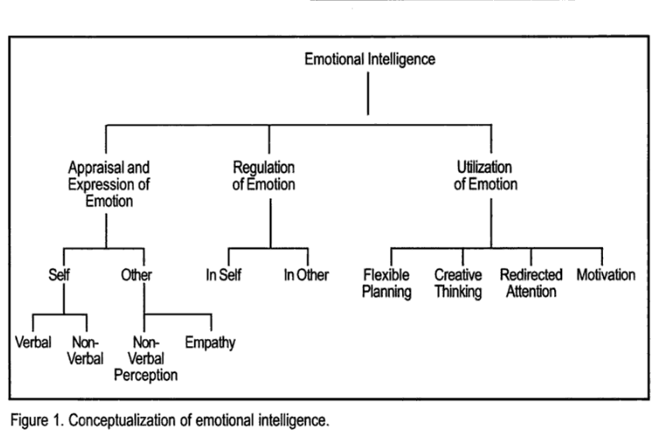
(Salovey, Brackett, and Mayer 2004)

Slide 14
To Explore
https://www.youtube.com/watch?v=7z0asInbu24
https://www.youtube.com/watch?v=auXNnTmhHsk

Slide 15
Models of EI
Ability model
BarOn model

Slide 16
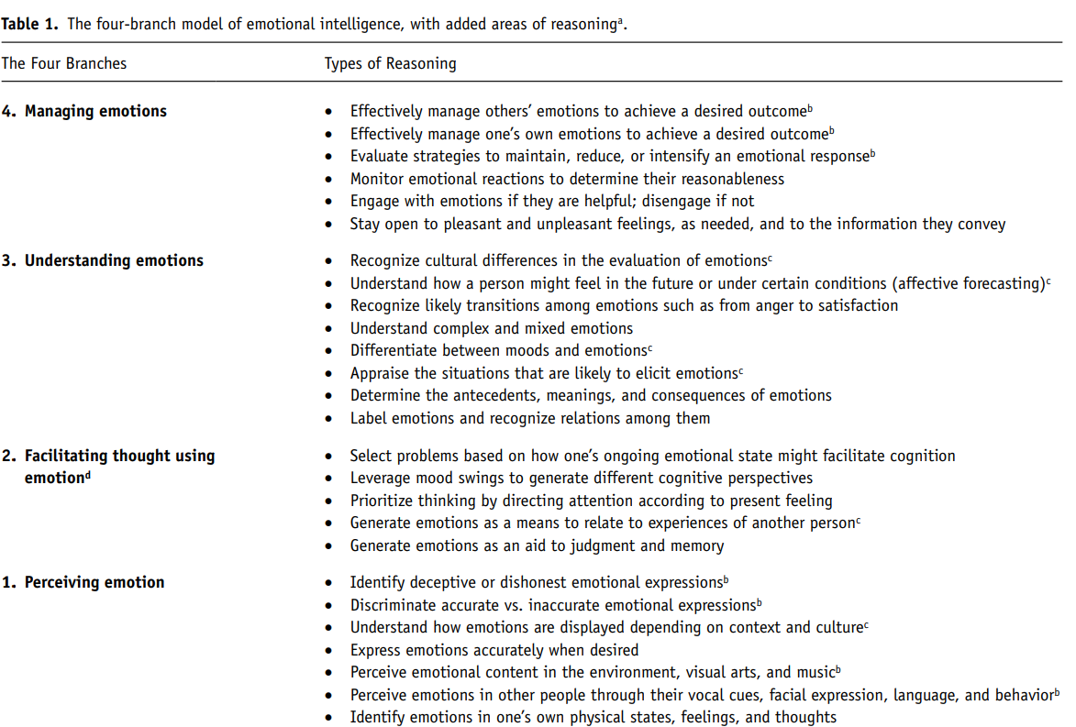
Ability Model

Slide 17
BarOn Model of EI
Intra-personal
Inter-personal
Adaptability
Stress management
General mood

Slide 18
BarOn Model of EI
ADAPTABILITY
Reality testing
Flexibility
Problem solving
STRESS MANAGEMENT
Stress tolerance
Impulse control
GENERAL MOOD
Optimism
Happiness
INTRAPERSONAL SCALES
Self-regard
Emotional self-awareness
Assertiveness
Independence
Self-actualization
INTERPERSONAL SCALES
Empathy
Social responsibility
Interpersonal relationship

Slide 19
4 Emotional Intelligent Domains
Self-awareness
Self-management
Social awareness
Leadership management
(Goleman, Boyatiz, and Mckee 2017)
Self-competencies
Social-competencies

Slide 20
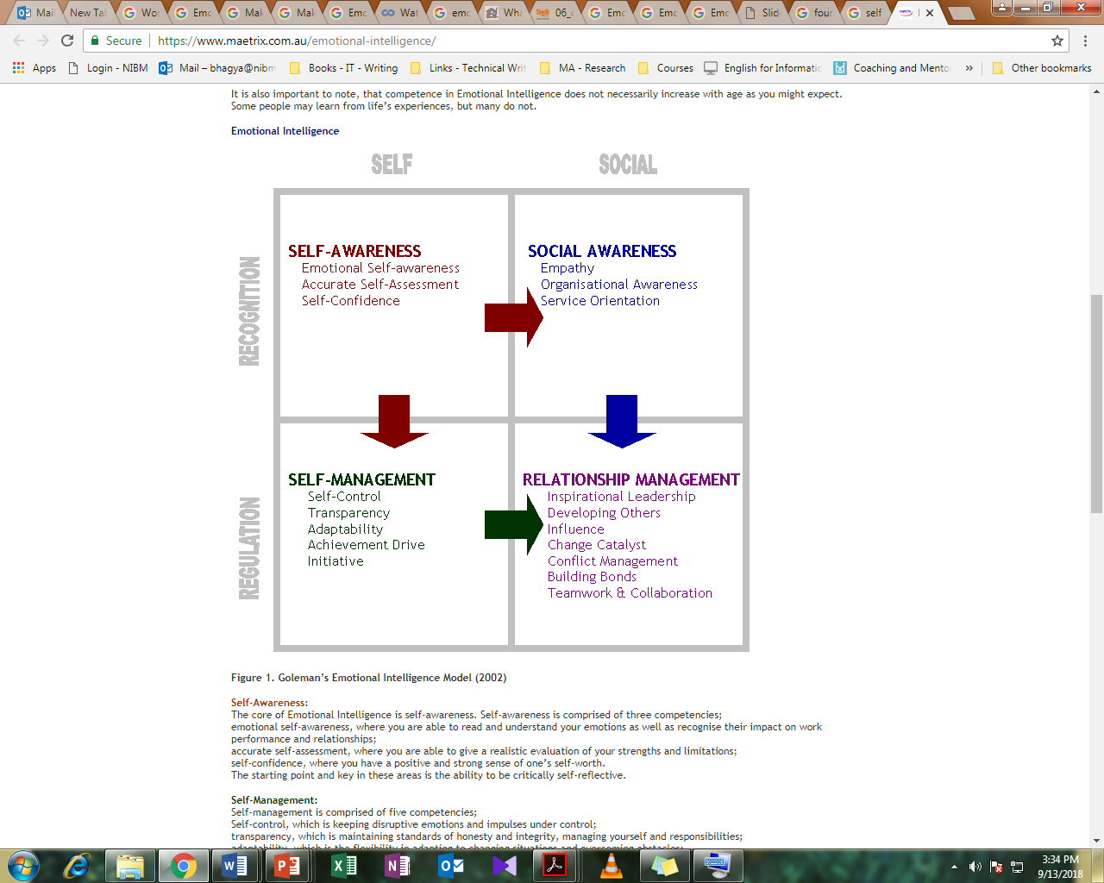

Slide 21
4 Emotional Intelligent Domains
Self-awareness
The most important dimension → is self-awareness.
Emotional self-awareness → where you are able to read and understand your emotions as well as recognise their impact on work performance and relationships
Accurate self-assessment → where you are able to give a realistic evaluation of your strengths and limitations;
Self-confidence→ where you have a positive and strong sense of one’s self-worth.
* Once an individual has developed these competencies, he/she can be self-reflective by criticising oneself.

Slide 22
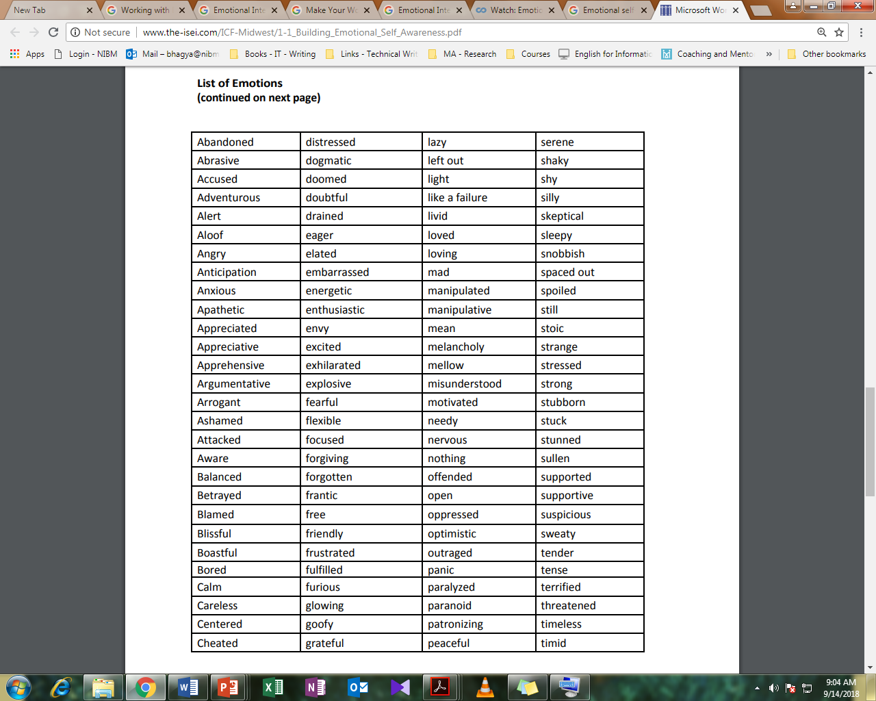

Slide 23
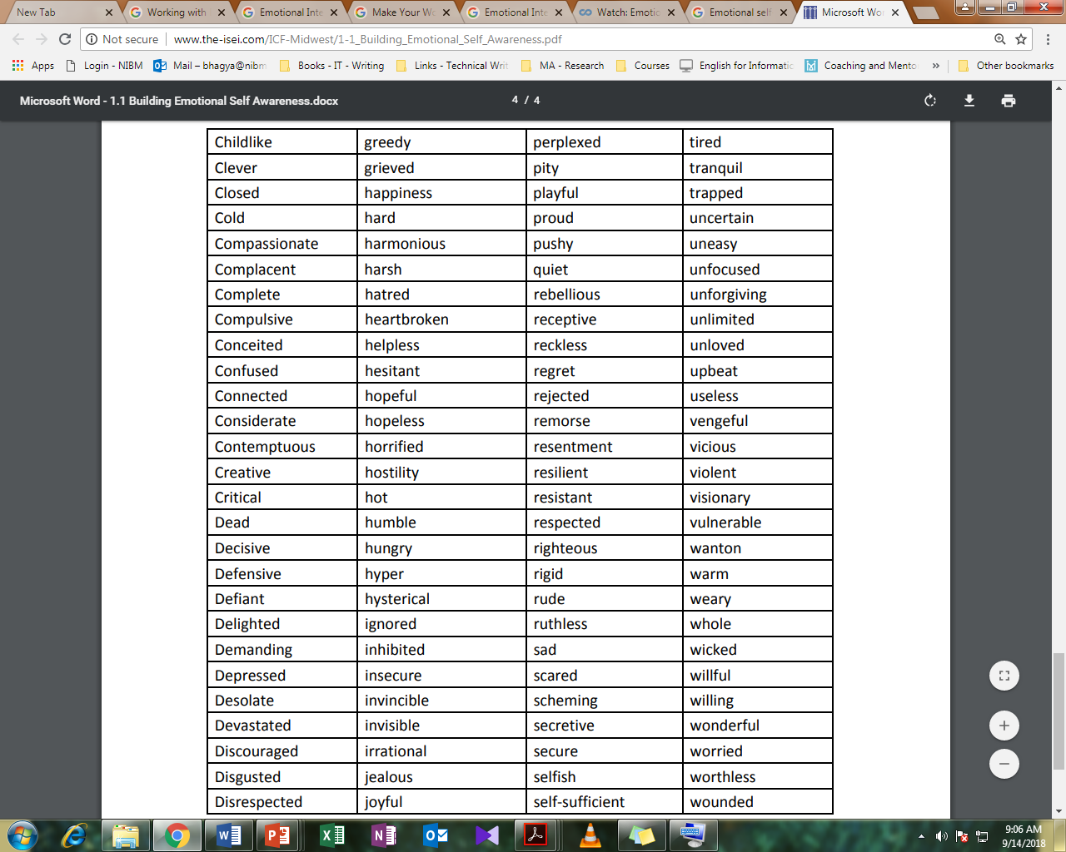

Slide 24
4 Emotional Intelligent Domains Cont.
Self-Management
Self-management is comprised of five competencies.
Self-control → which is keeping disruptive emotions and impulses under control.
Transparency → which is maintaining standards of honesty and integrity, managing yourself and responsibilities.
Adaptability → which is the flexibility in adapting to changing situations and overcoming obstacles.
Achievement orientation → which is the guiding drive to meet an internal standard of excellence.
Initiative → which is the readiness to seize opportunities and act.

Slide 25
4 Emotional Intelligent Domains Cont.
Social Awareness
Social Awareness is comprised of three competencies.
Empathy → which is understanding others and taking an active interest in their concerns.
Organisational awareness → which is the ability to read the currents of organisational life build decision networks and navigate politics.
Service orientation → which is recognising and meeting customers’ needs.

Slide 26
4 Emotional Intelligent Domains Cont.
Relationship Management
The Social cluster of Relationship Management is comprised of seven competencies.
Visionary leadership → which is inspiring and guiding groups and individuals.
Developing others → which is the propensity to strengthen and support the abilities of others through feedback and guidance.
Influence → which is the ability to exercise a wide range of persuasive strategies with integrity, and also Includes listening and sending clear → convincing and well-tuned messages.
Change catalyst → which is the proficiency in initiating new ideas and leading people in a new direction.

Slide 27
4 Emotional Intelligent Domains Cont.
Relationship Management
Conflict management → which is resolving disagreements and collaboratively developing resolutions.
Building bonds → which is building and maintaining relationships with others.
Teamwork and collaboration → which is the promotion of cooperation and building of teams.

Slide 28
Organisational EI
An emotionally intelligent individual is able to handle him/herself well. He/she is self-aware and can manage impulsive emotions. Such an individual can tap into positive emotions. He/she can face conflicts well. He/she also knows how a team with high performance can be formed.

Slide 29
Organisational EI
“Communication skills of the software professional here are of utmost importance to communicate, understand and translate what the customer wants and then get the satisfaction of the customer on ‘what’s translated is actually what’s needed’” (Zahid, Waseem, and Raziq 2008)
According to Zahid, Waseem, and Raziq (2008) communication skills in an individual requires him/her to understand others and through that to convince them, understand the needs, and translate the needs into products.

Slide 30
References
Cassady, J.C. and Eissa, M.A. (2008) Emotional Intelligence: Perspectives on Educational and Positive Psychology. New York: Peter Lang
Goleman, D., Boyatzis, R.E., and McKee, A. (2017) Primal Leadership: Unleashing the Power of Emotional Intelligence. Boston, MA: Harvard Business Review Press
Salovey, P., Brackett, M.A., and John, M.D. (2007) Emotional Intelligence: Key Readings on the Mayer and Salovey Model. Port Chester, NY: Dude Publ.

